Slide 1

DATABMU
Adult Dataset

Slide 2

Problem Statement
To predict whether the income exceeds $50K/yr based on census data
Adult Dataset

Slide 3
Important Features
Education
Maritial-Status
Occupation
Relationship
Categorical
Age
Hours-per-week
Numerical

Slide 4
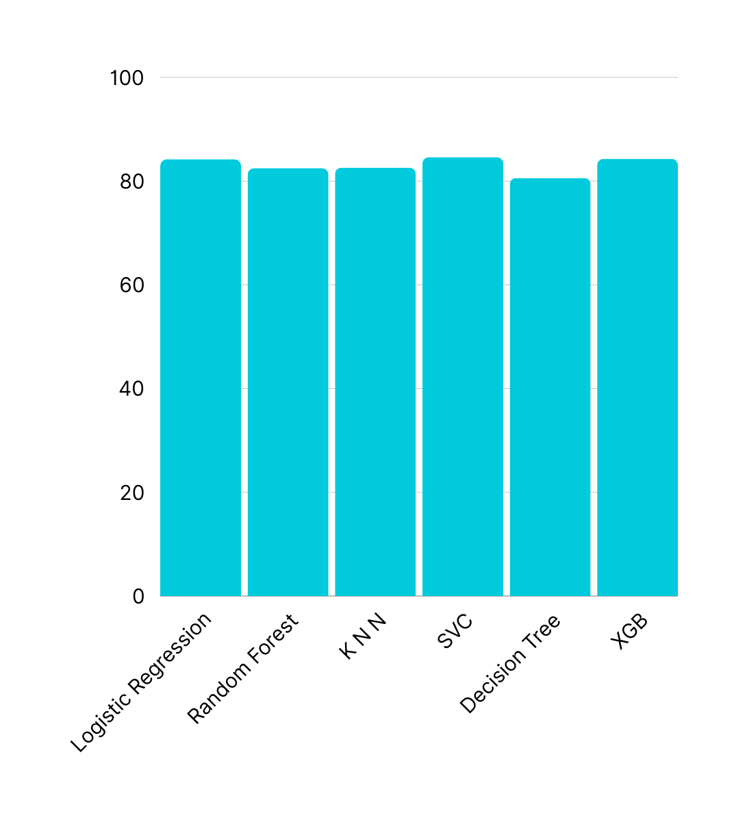
Methods
Logistic Regression
Random Forest
K Nearest Neighbors
Support Vector Classifier
Decision Tree
XGB Classifier

Slide 5
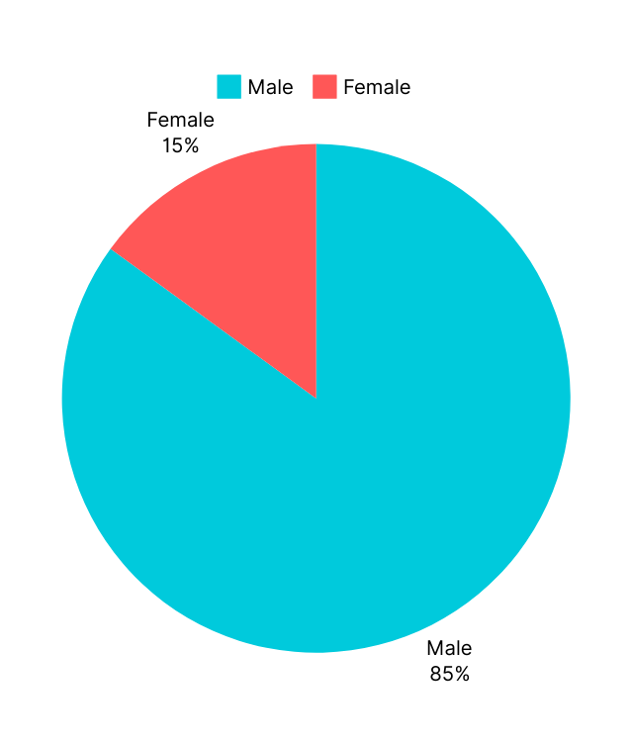
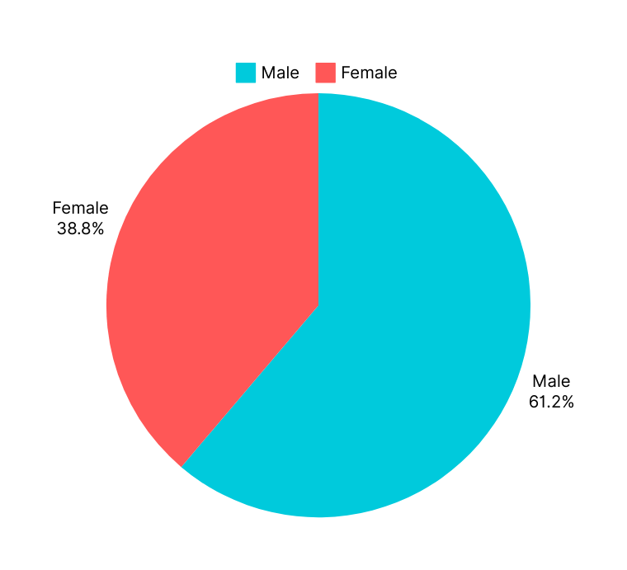
Comparison of male and female
>50k
<=50k

Slide 6
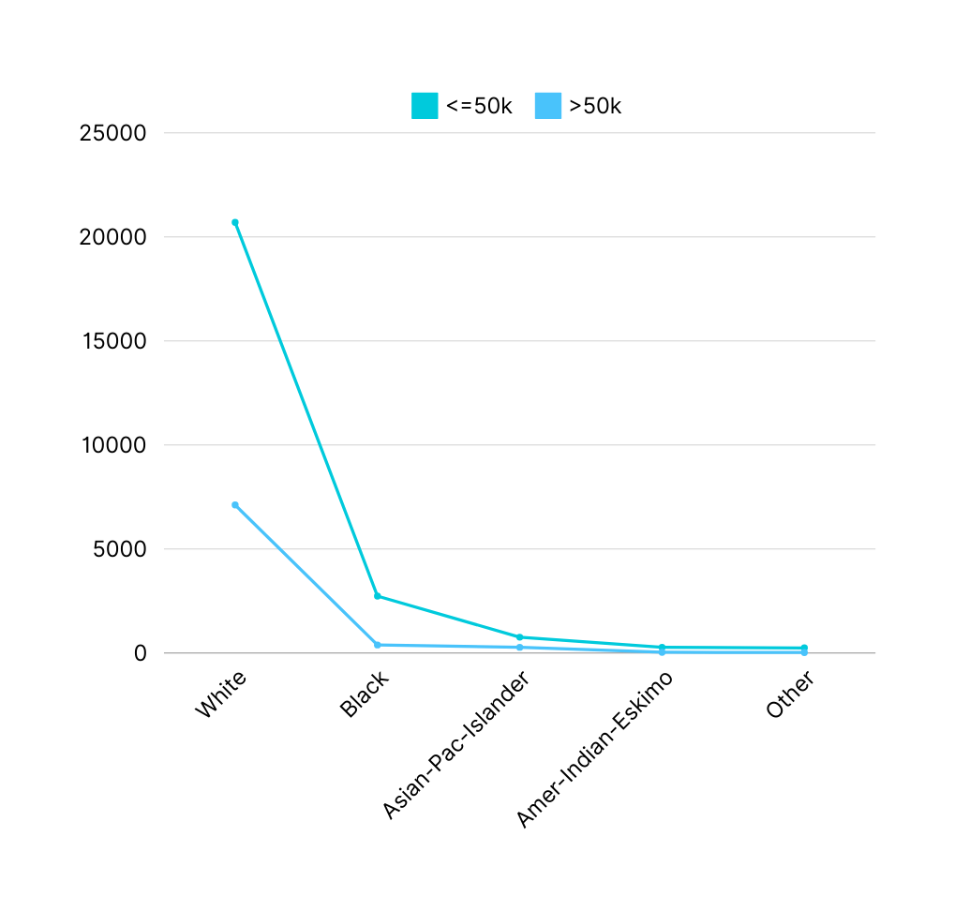
Race vs people earning <=50k & >50k
We can infer from the plot that the white have more income compared to other races

Slide 7
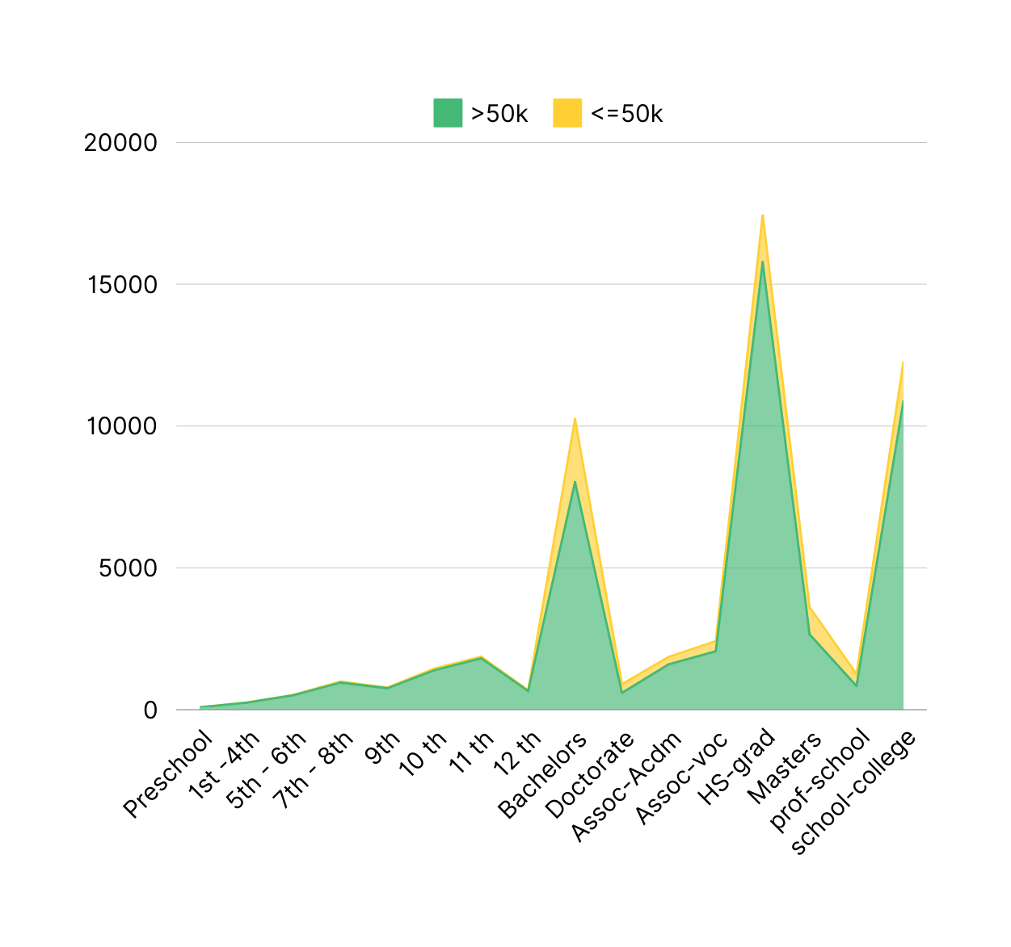
Education Category vs Earnings <=50k & >50k

Slide 8
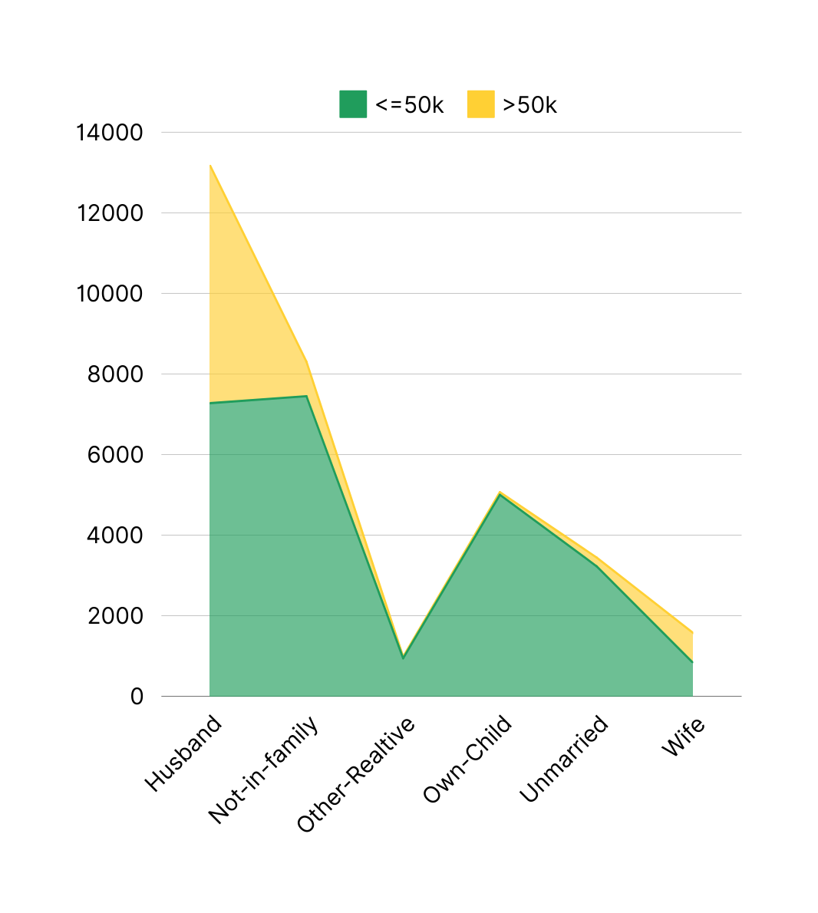
Relationship Status vs Earnings <=50k & >50k

Slide 9


Lets see some inferences through Power Bi ML models

Slide 10



